Slide 1

F1 App
Customer Experience Management
2024/25
Andrzej Janik

Slide 2

F1 App Features
Comprehensive Data Access - Centralized platform for in-depth analysis of race session data, with detailed performance insights.
Dynamic Comparisons - Visualize and compare driver performances through interactive tables and charts.
Highlighting Key Race Moments - Curated section for highlights, allowing fans to revisit the most significant moments of each race session.
Real-Time Interaction - Engage with other fans via live chat, fostering discussions as the race unfolds.

Slide 3
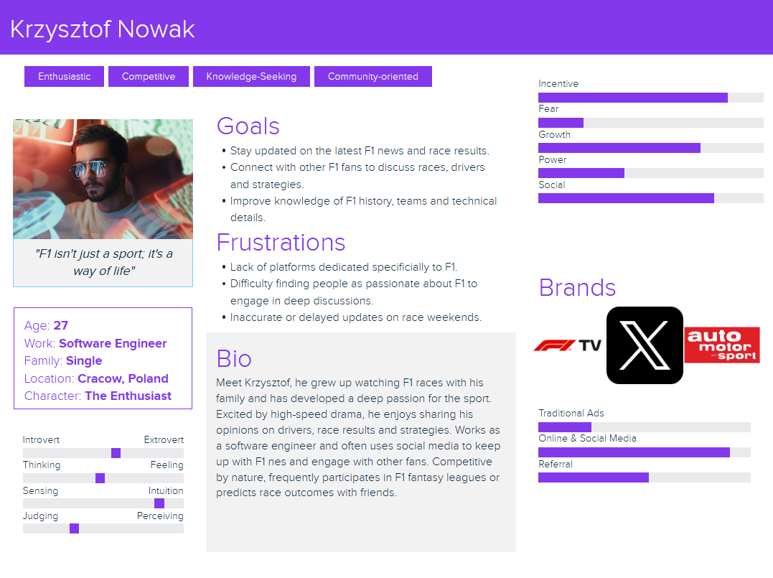
Customer Persona

Slide 4
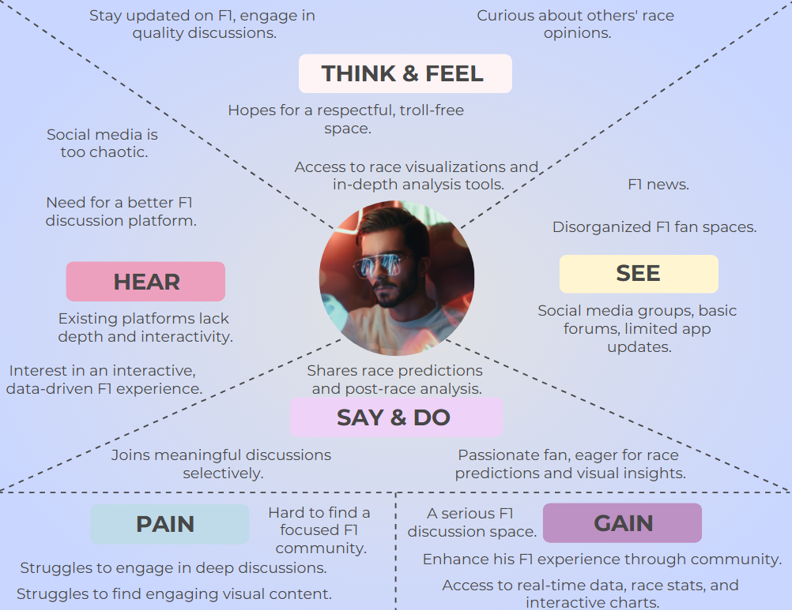
Customer Empathy Map

Slide 5
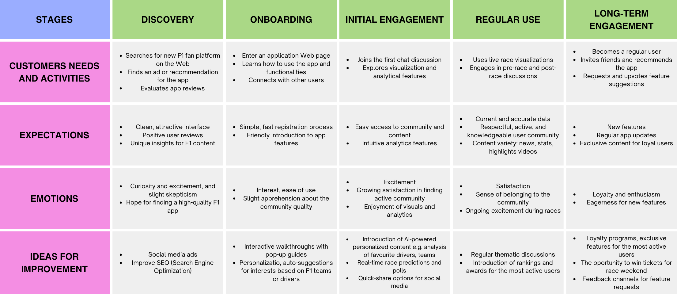
Customer Journey Map

Slide 6

Customer Satisfaction Survey

Slide 7
Customer Satisfaction Survey
Customer Satisfaction Survey consists of 10 question.
Measures customer satisfaction using Net Promoter Score (NPS).
Provides valuable insights for continuous improvement.
Designed to be quick and easy for respondents.

Slide 8
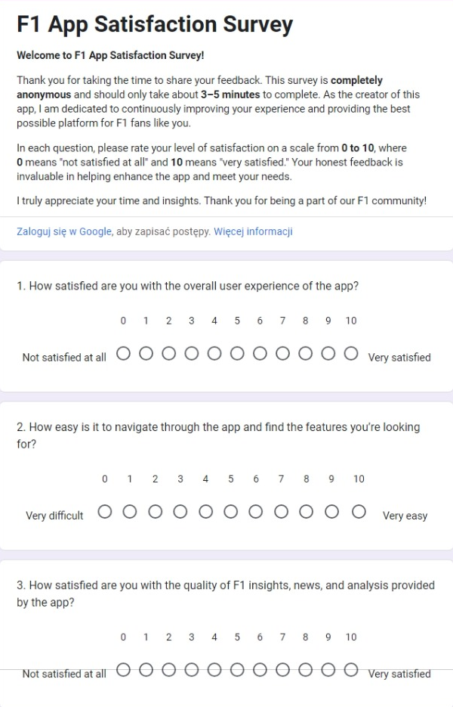
Part 1

Slide 9
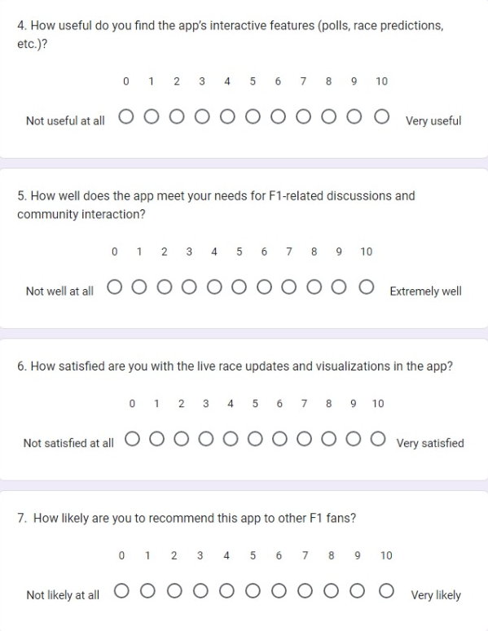
Part 2

Slide 10
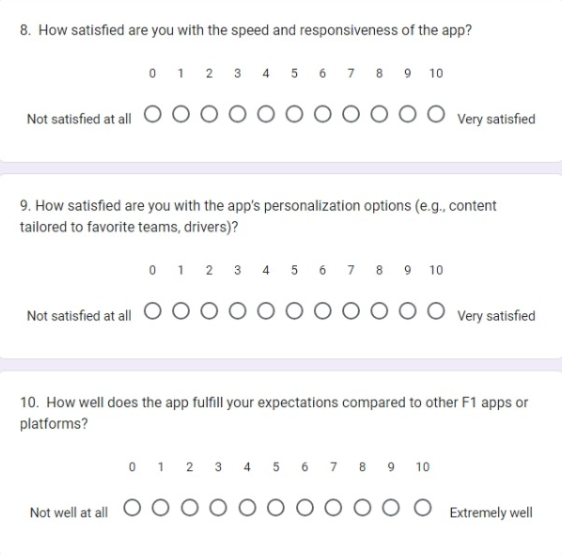
Part 3

Slide 11
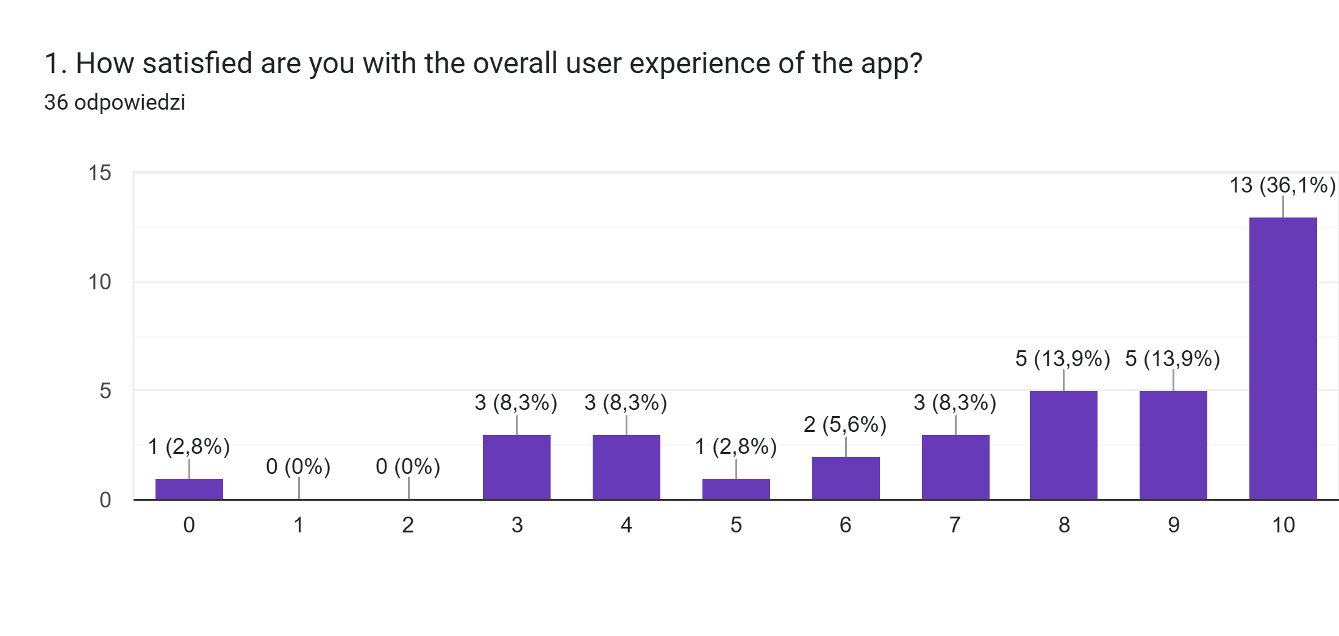
How satisfied are you with the overall user experience of the app?

Slide 12
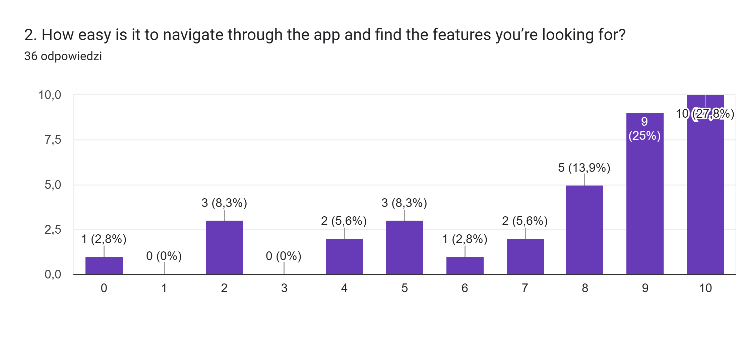
How easy is it to navigate through the app and find the features you’re looking for?

Slide 13
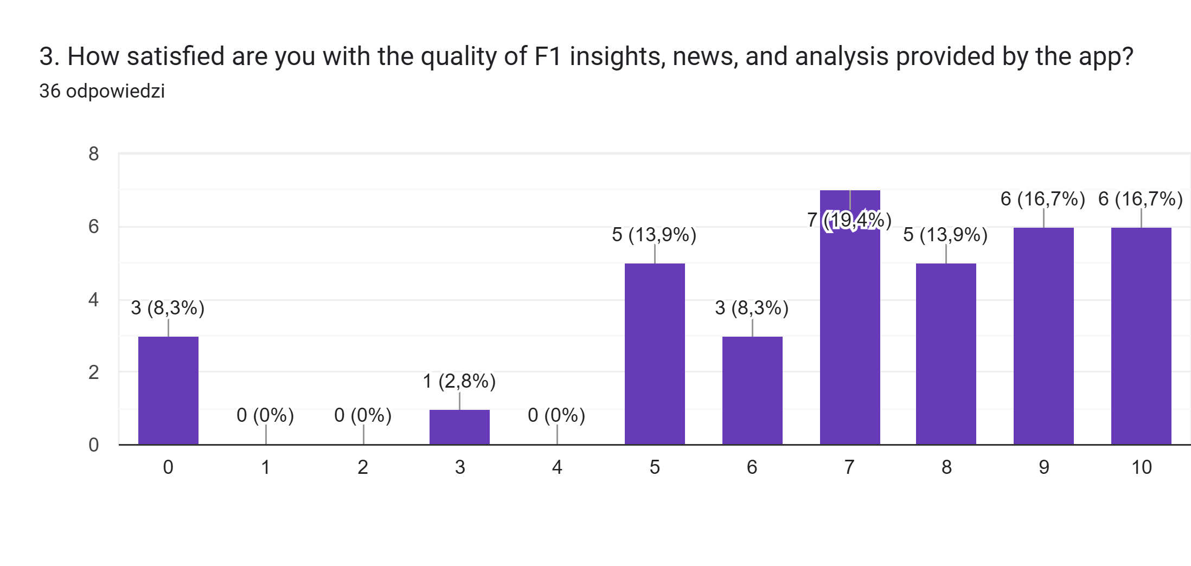
How satisfied are you with the quality of F1 insights, news, and analysis provided by the app?

Slide 14
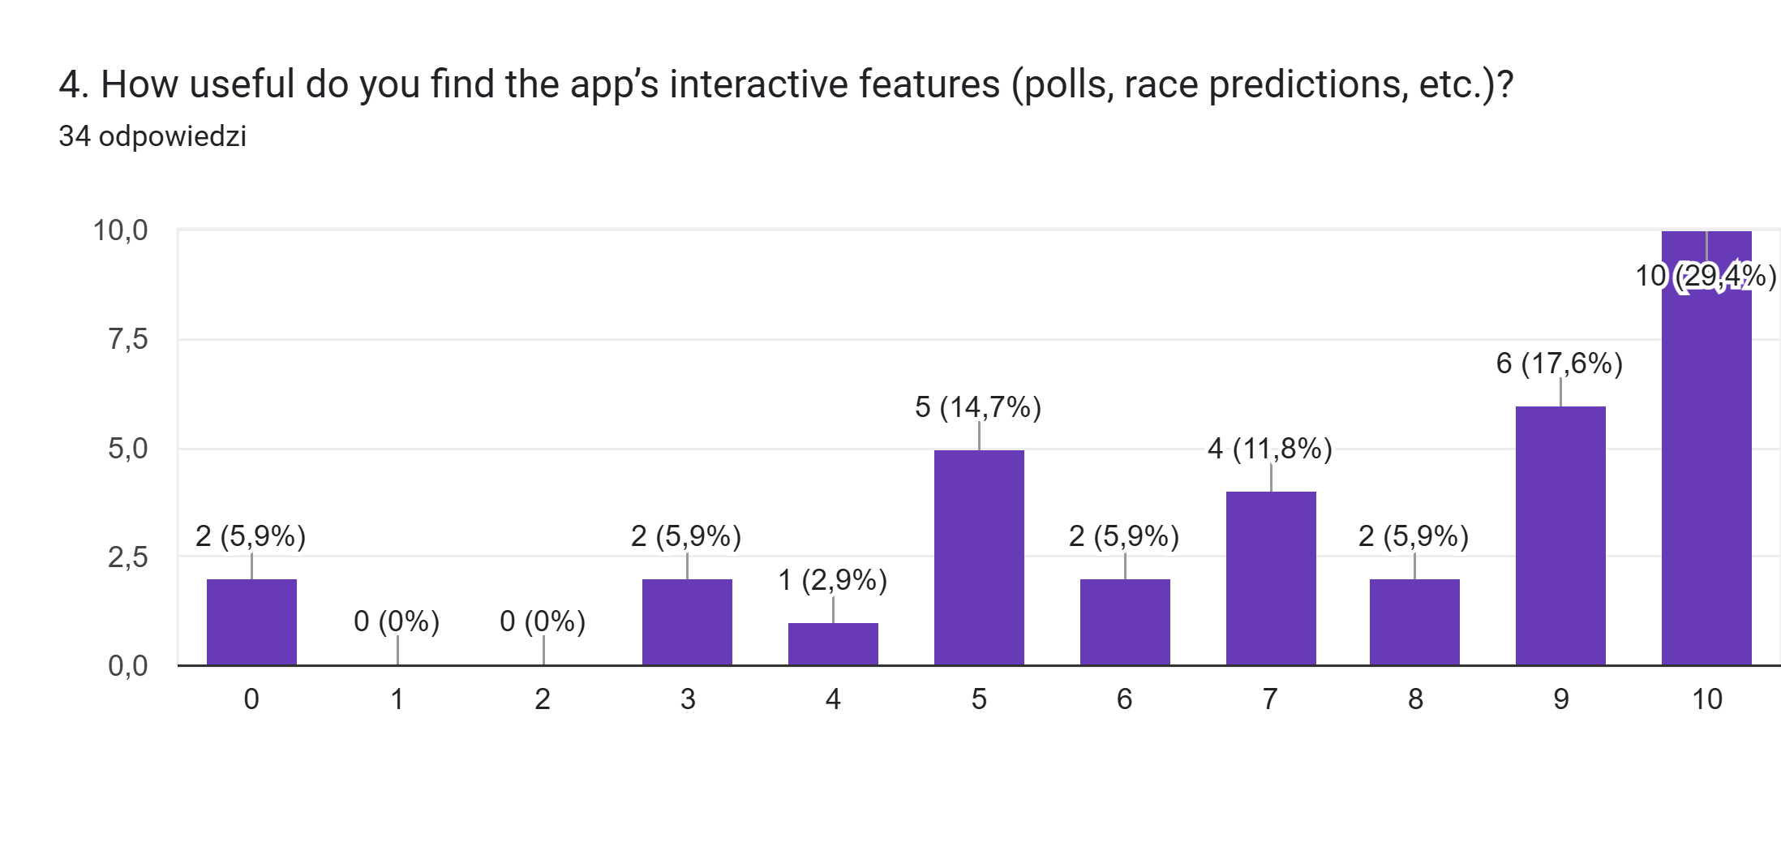
How useful do you find the app’s interactive features (polls, race predictions, etc.)?

Slide 15
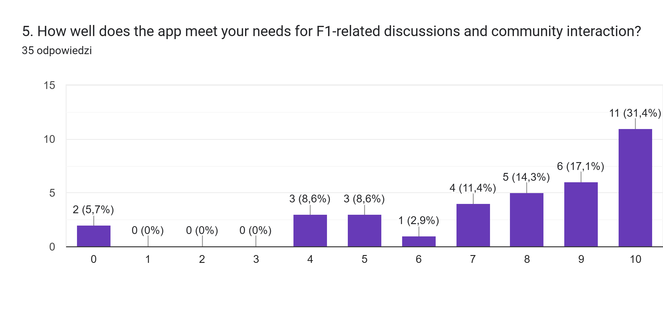
How well does the app meet your needs for F1-related discussions and community interaction?

Slide 16
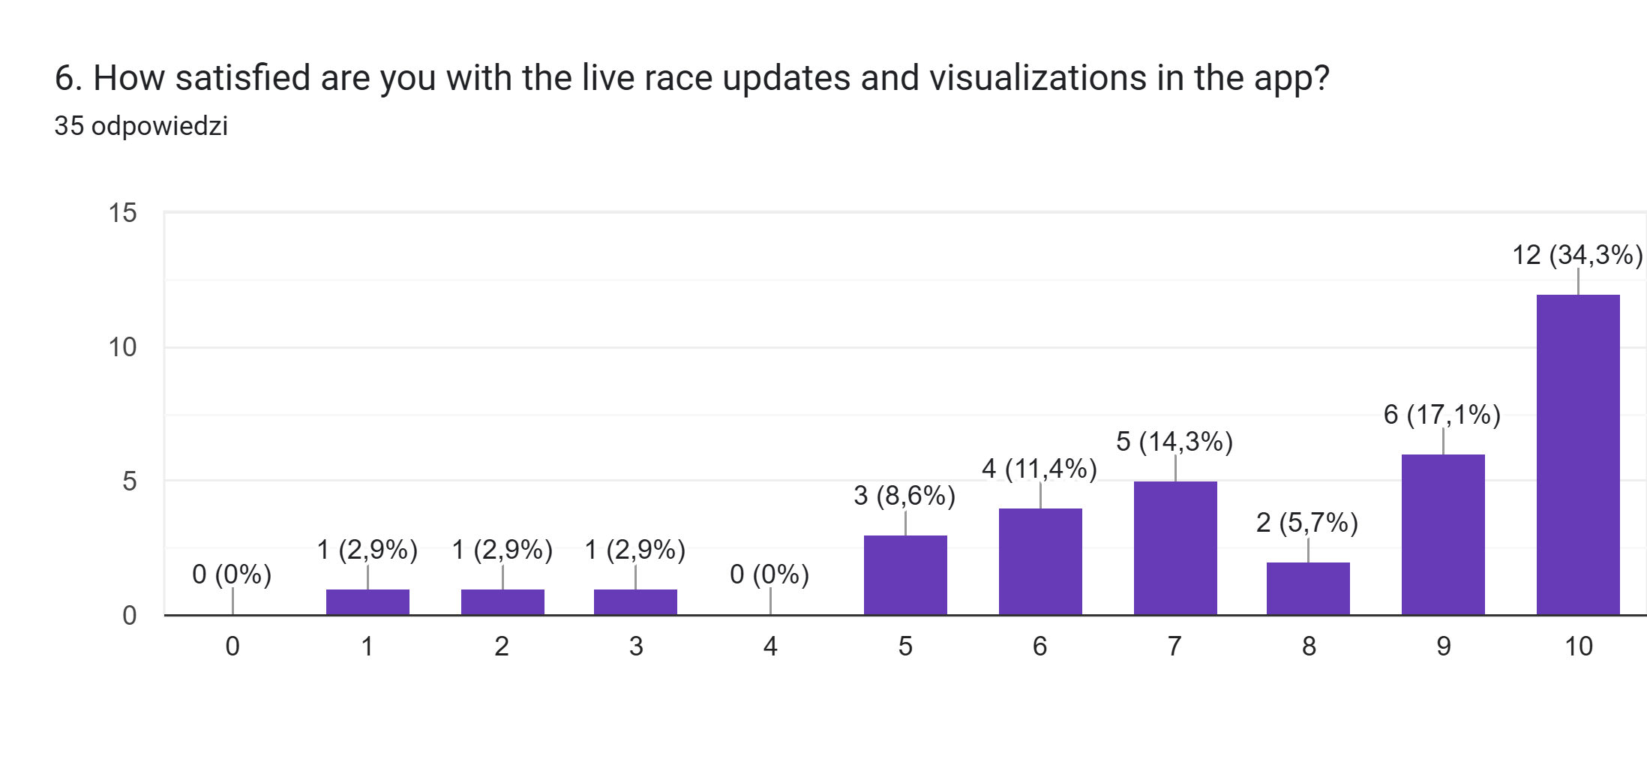
How satisfied are you with the live race updates and visualizations in the app?

Slide 17
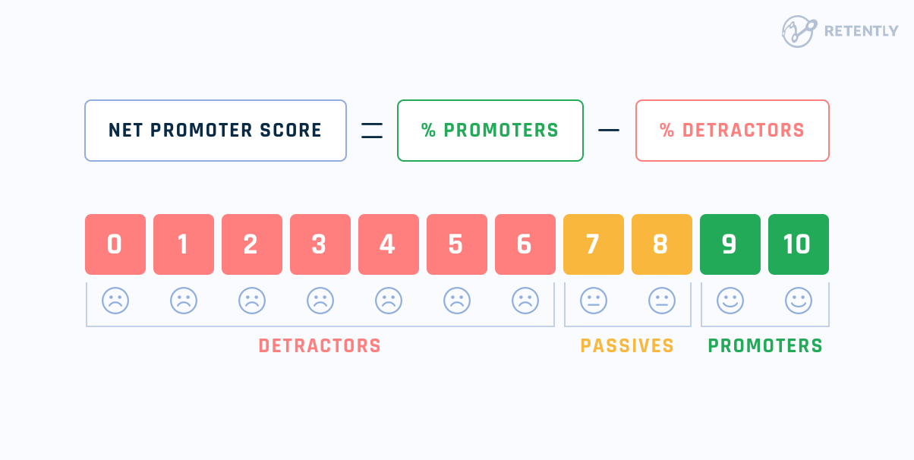
Net Promoter Score

Slide 18
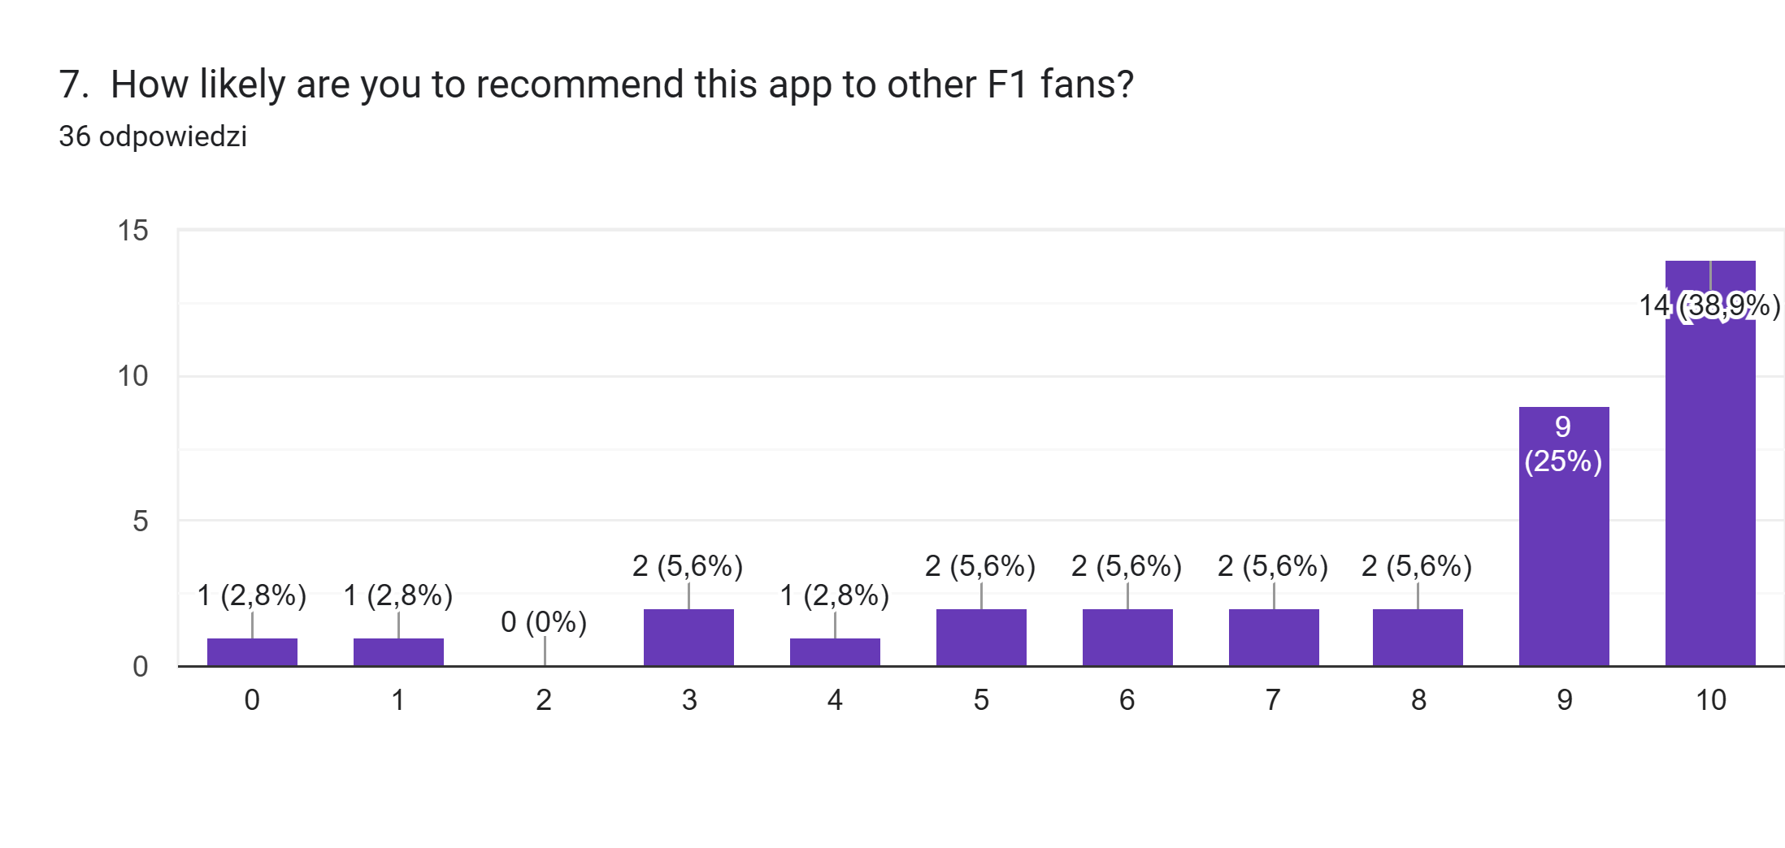
How likely are you to recommend this app to other F1 fans?

Slide 19
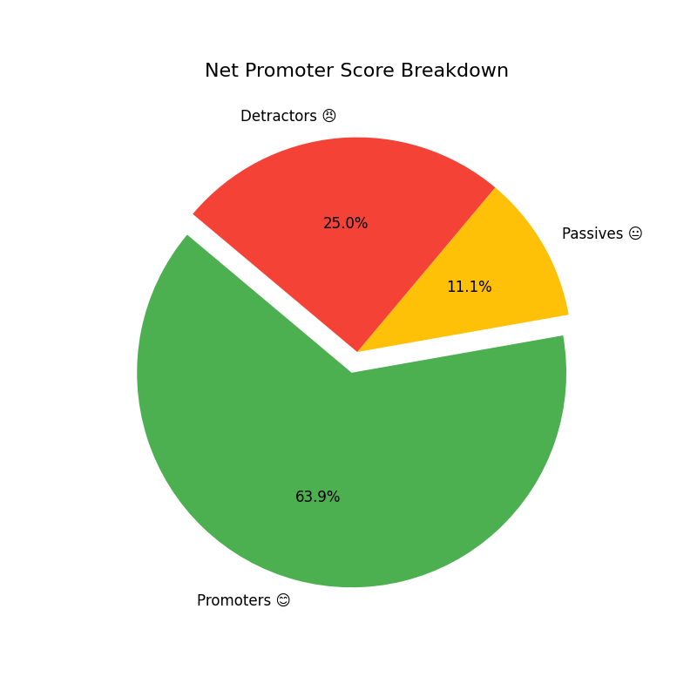
Net Promoter Score
The NPS survey gathered 36 responses. With 23 promoters, 4 passives, and 9 detractors, the Net Promoter Score achieved was 38.9%.

Slide 20
Understanding NPS Results
Positive Feedback: NPS of 38.9% reflects a strong base of satisfied users (promoters).
Opportunities for Growth: Presence of detractors (25%) highlights areas for improvement.
Encouraging Outcome: Majority are likely to recommend the app, indicating good user engagement.
Next Steps: Focus on addressing detractor concerns to boost satisfaction and retention.

Slide 21
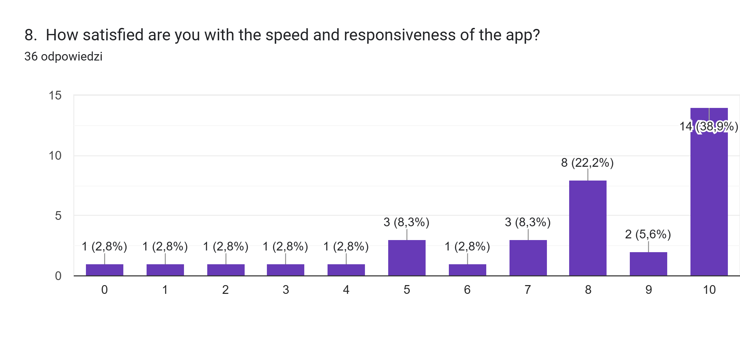
How satisfied are you with the speed and responsiveness of the app?

Slide 22
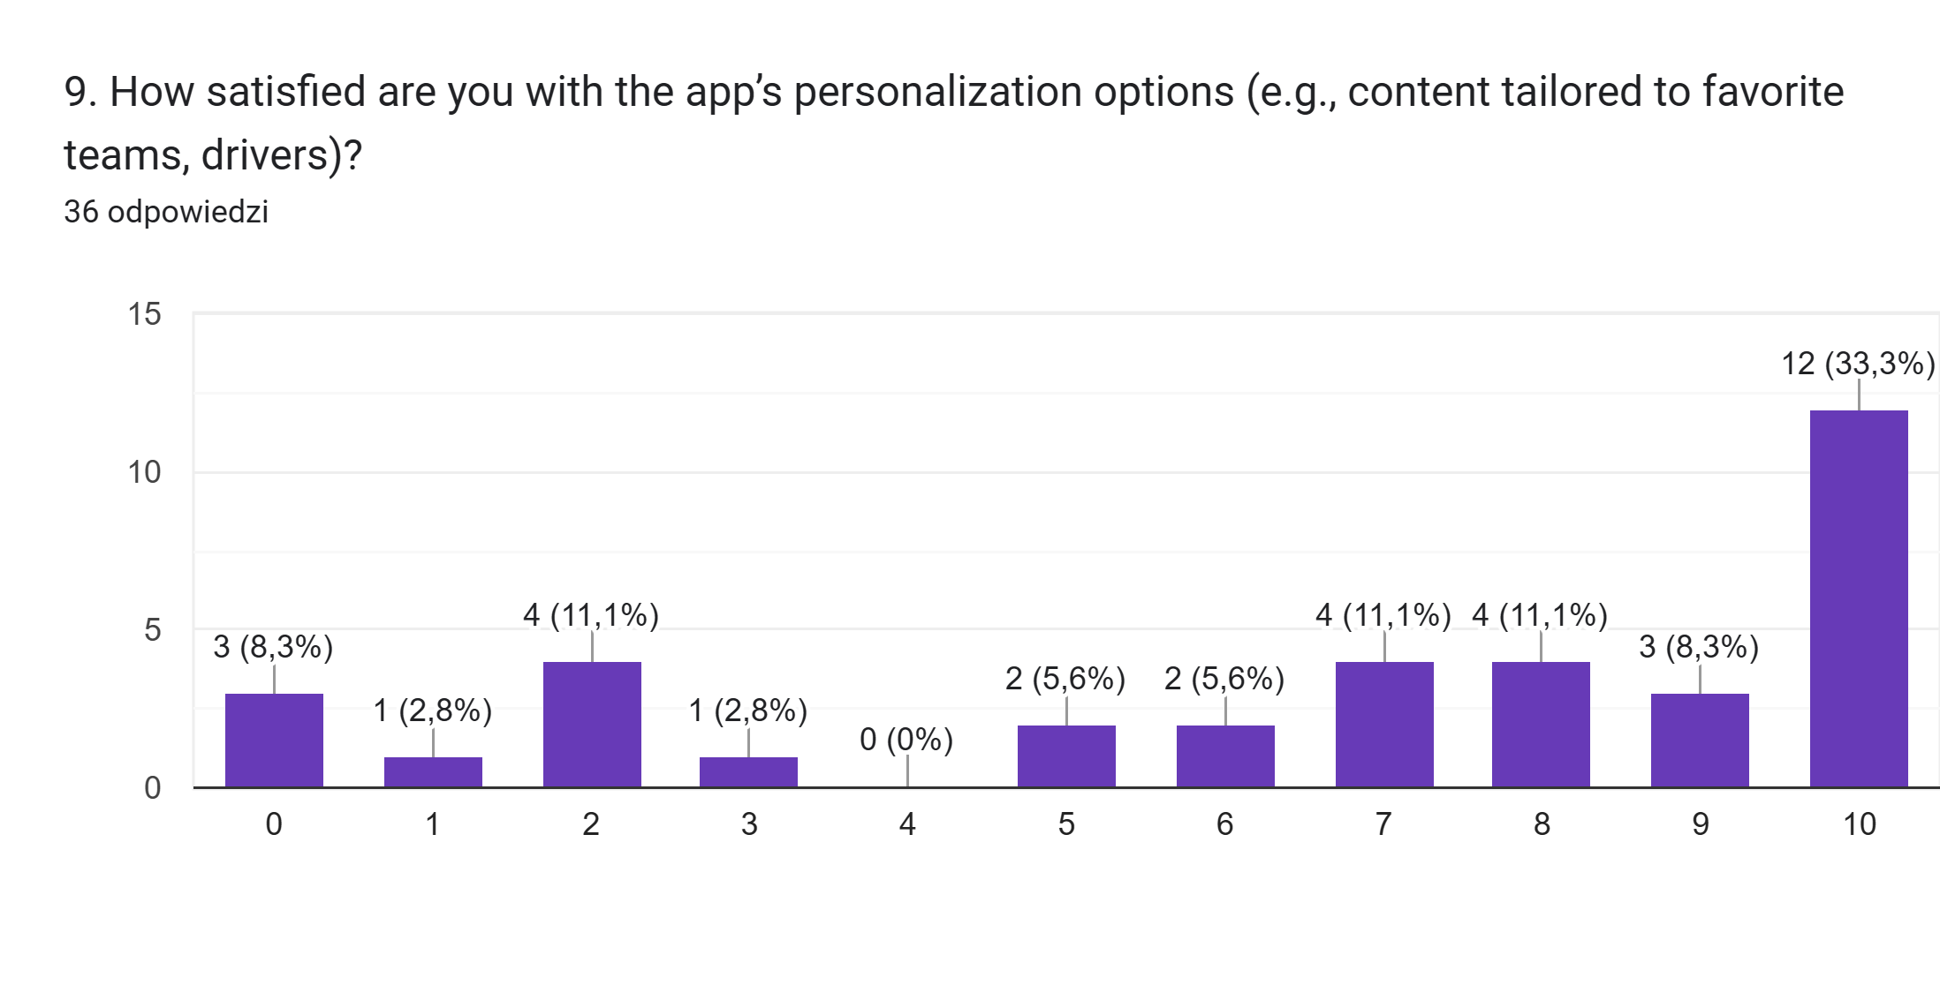
How satisfied are you with the app’s personalization options (e.g., content tailored to favorite teams, drivers)?

Slide 23
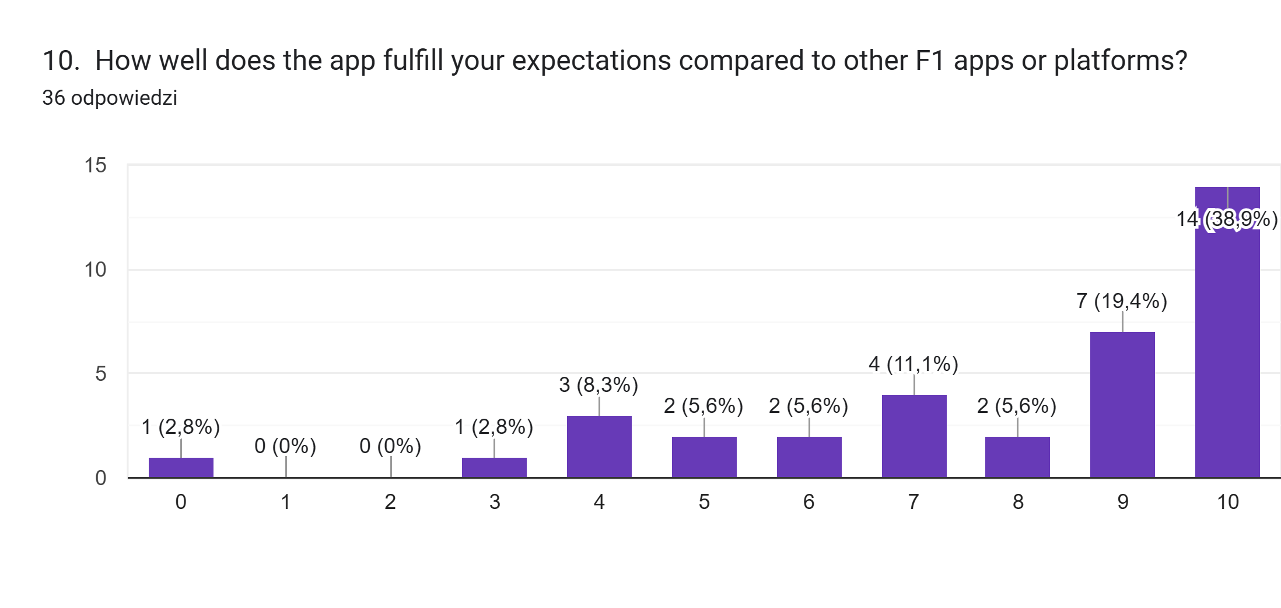
How well does the app fulfill your expectations compared to other F1 apps or platforms?

Slide 24

CEM implementation in the organization

Slide 25

Comparison of Top CEM Software Solutions of 2024
Freshdesk
Qualaroo
Zendesk

Slide 26
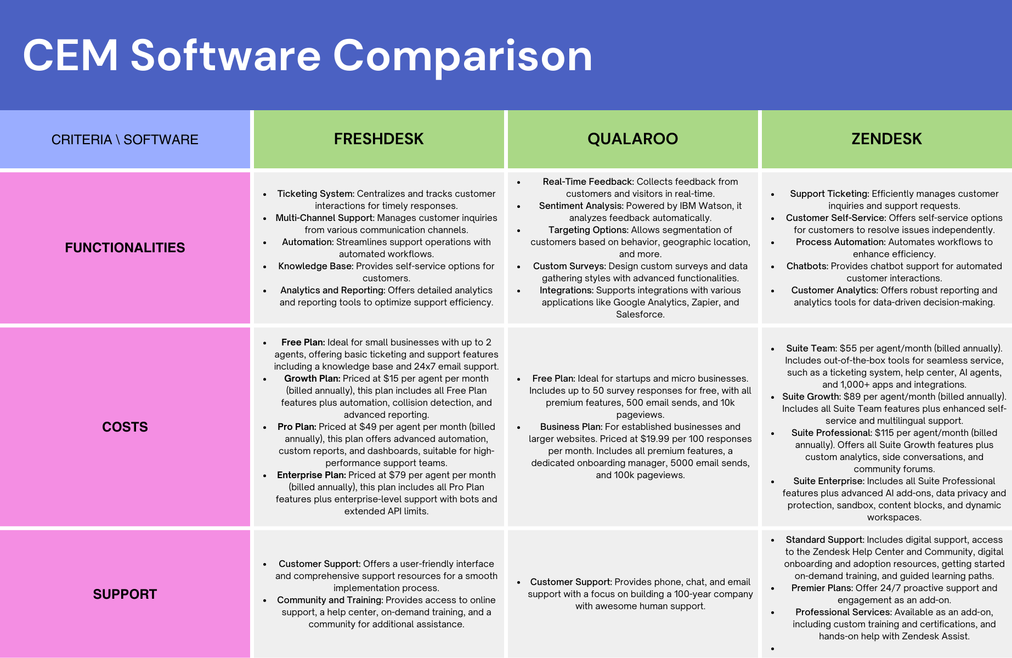

Slide 27

Plan of Software implementation in F1 App
Plan includes the following stages:
CEM Software Selection & Integration
Feedback Collection & User Engagement
Real-Time Support & Analytics
Continuous Improvement

Slide 28
Stage 1 – CEM Software Selection & Integration
The objective is to choose and integrate the right CEM software for managing user engagement and feedback in the F1 app.
Key Actions:
Select CEM software based on core features: feedback management, real-time features, personalization, cost and support.
Integrate the CEM software into the app to manage user feedback and track customer satisfaction.
Ensure compatibility with app data, user interactions, and customer support features.

Slide 29
Stage 2 – Feedback Collection & User Engagement
The objective is to gather continuous feedback to enhance the user experience and engage users effectively.
Key actions:
Implement Customer Satisfaction Surveys (e.g., NPS) to measure user sentiment.
Analyze user behavior within the app (e.g., preferences, activity patterns) for personalization.

Slide 30
Stage 3 – Real-Time Support & Analytics
Provide real-time support and analyze user data to improve app features and support.
Key Actions:
Integrate real-time chat support for addressing user queries and issues.
Use analytics dashboards to track user satisfaction, app interactions, and engagement metrics.

Slide 31
Stage 4 – Continous Improvement
Use ongoing feedback to optimize the F1 app and maintain high levels of user satisfaction.
Key Actions:
Track user satisfaction regularly using NPS and feedback surveys.
Iterate on features based on feedback, improving personalization and overall experience.
Monitor engagement metrics to assess the success of implemented features and ensure customer retention.

Slide 32
CEM Software Choice - Zendesk
Why Zendesk for F1 App:
Supports all communication channels (email, chat, social media), which is essential for F1 fans.
Provides real-time interactions and chatbots, crucial for addressing issues quickly during live events like races.
Automates workflows, reducing response time and providing data-driven insights to optimize user experience

Slide 33
Business Justification and Cost Analysis
Critical Features:
Zendesk offers all necessary features such as customizable workflows, multi-channel support, and automation that are critical for the F1 App.
Cost Effectiveness:
Suite Team plan provides comprehensive tools at a competitive rate, ideal for small to mid-sized teams.
As the app scales, upgrading to Suite Growth or Suite Enterprise ensures future flexibility.

Slide 34
Overall Summary of F1App

Slide 35

Purposes of F1App
Elevate the fan experience for F1 enthusiasts by offering:
Data-driven insights for in-depth race analysis.
Dynamic tools for comparisons and enhanced engagement.
A sense of community through interactive features.

Slide 36
CustomerCentric Approach
Utilizes empathy maps to understand fan needs and expectations.
Implements customer journey mapping to track the user experience across the app’s features.
Conducts satisfaction surveys, such as Net Promoter Score (NPS), to gather valuable feedback for continuous improvement.
Ensures a fan-focused strategy by aligning the app’s updates and features with user preferences and feedback.

Slide 37

Key Takeaways
Strong Foundations:
NPS of 38.9% demonstrates solid user engagement and potential for growth.
Integration of Zendesk ensures seamless customer support.
Opportunities for Improvement:
Addressing detractor feedback will improve retention and satisfaction.
Continuous enhancements to personalization and speed.
Future Outlook:
Commitment to leveraging analytics and feedback for sustained user satisfaction.

Slide 38

Path Forward
Continuous Optimization:
Regular surveys and engagement metrics to align with user needs.
Refining features for personalization and interactivity.
Scalable Growth:
Flexibility in CEM software upgrades (Zendesk) ensures long-term adaptability.
Expansion of community features to strengthen fan connections.

Slide 39

Thank You!

